Slide 1
Using AI Hardware Acceleration to Detect Real-Time Crowd and Traffic Conditions
Andy Chen, Michael Sekyi, Jack Herbert

Slide 2

The Problem
Excessive crowd and traffic conditions on Engineer’s way
Delays to students, professors, and staff
Solution: Get real-time data to empower travelers to make better informed decisions
Sanjay Suchak, University Communications

Slide 3
Objectives
Crowd Density Detection: Develop a robust computer vision model using Hailo 8 on Raspberry Pi to detect crowd density in real-time and categorize it into different levels (e.g., low, medium, high) based on traffic patterns along Engineer's Way.
Alert System Integration: Create an alert system that can inform users or systems when high-density traffic conditions are detected, potentially integrating with mobile apps or campus information boards.
Energy Efficiency and Processing Optimization: Leverage the hardware acceleration provided by Hailo 8 to ensure the system runs efficiently, with low latency, minimal energy consumption, and optimized processing for real-time applications.
Scalability and Deployment Strategy: Design a scalable solution that can easily be deployed across multiple pathways or locations on campus, providing consistent and accurate data on foot traffic.

Slide 4
Technology Stack
Hardware: Raspberry Pi with Hailo 8 AI processor, camera module (for image capture), Wi-Fi module for data transmission.
Software: Python, OpenCV, TensorFlow Lite (optimized for edge devices), Hailo SDK for model deployment and optimization, MQTT or WebSocket for data transmission and alert notifications.

Slide 5
Expected Outcomes
Real-Time Traffic Analysis Model: A working computer vision model that identifies and categorizes crowd density levels on Engineer's Way with at least 70% accuracy.
Real-Time Dashboard and Alert System: A dashboard displaying crowd density data with the ability to send real-time alerts based on pre-defined thresholds.
Low-Power Edge AI Solution: A model optimized to run on the Raspberry Pi + Hailo 8 with minimal power consumption while maintaining real-time performance.
Scalable Documentation: Detailed project documentation, including setup guides, configuration steps, and recommendations for deploying additional nodes on other pathways

Slide 6
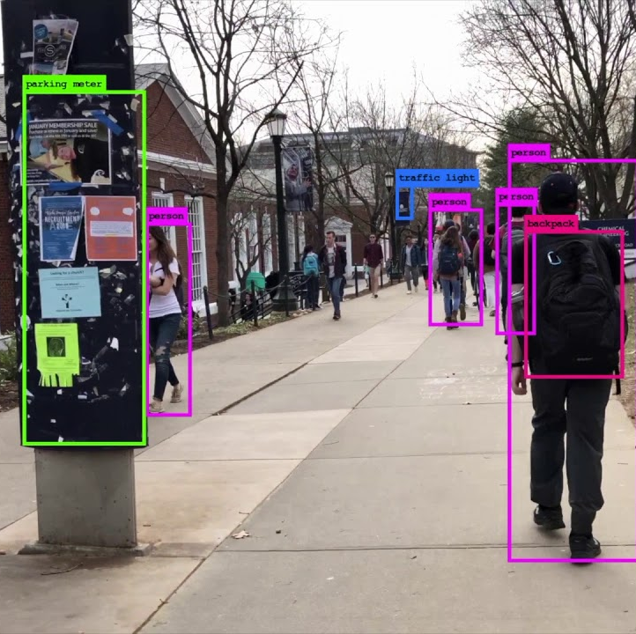
Timeline
Week 1: Planning and Research
Week 2: Data Collection and Model Training
Week 3: Model Optimization and Testing
Week 4: System Integration and Deployment
Suh, Jacob. Computer Vision at UVa - Engineer's Way. YouTube, https://www.youtube.com/watch?v=OjCa15e2b4M&ab_channel=JacobSuh.

